Slide 1
CHAPTER 8
CLASSICAL RELATIONS AND FUZZY RELATIONS
“Principles of Soft Computing, 2nd Edition”
by S.N. Sivanandam & SN Deepa
Copyright © 2011 Wiley India Pvt. Ltd. All rights reserved.

Slide 2
RELATIONS
  Relations represent mappings between sets and connectives in logic.
  A classical binary relation represents the presence or absence of a connection or interaction or association between the elements of two sets.
  Fuzzy binary relations are a generalization of crisp binary relations, and they allow various degrees of relationship (association) between elements.
“Principles of Soft Computing, 2nd Edition”
by S.N. Sivanandam & SN Deepa
Copyright © 2011 Wiley India Pvt. Ltd. All rights reserved.

Slide 3
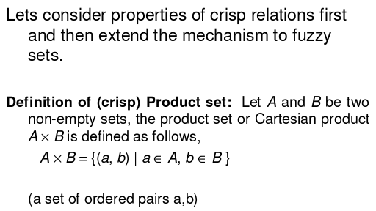
CRISP CARTESIAN PRODUCT
“Principles of Soft Computing, 2nd Edition”
by S.N. Sivanandam & SN Deepa
Copyright © 2011 Wiley India Pvt. Ltd. All rights reserved.

Slide 4
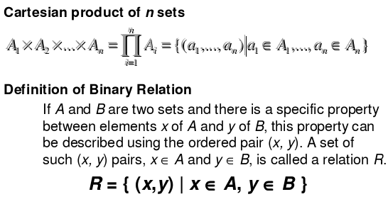
CRISP RELATIONS
“Principles of Soft Computing, 2nd Edition”
by S.N. Sivanandam & SN Deepa
Copyright © 2011 Wiley India Pvt. Ltd. All rights reserved.

Slide 5
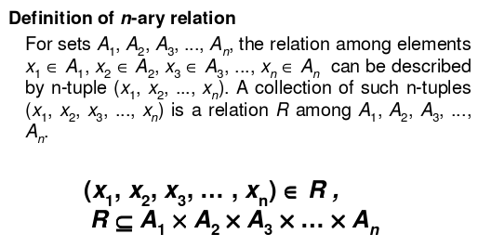
“Principles of Soft Computing, 2nd Edition”
by S.N. Sivanandam & SN Deepa
Copyright © 2011 Wiley India Pvt. Ltd. All rights reserved.

Slide 6
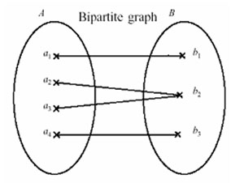
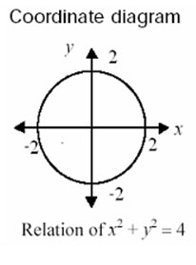
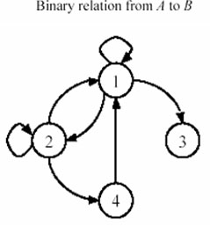
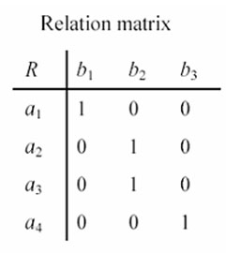
CRISP BINARY RELATIONS
Examples of binary relations
“Principles of Soft Computing, 2nd Edition”
by S.N. Sivanandam & SN Deepa
Copyright © 2011 Wiley India Pvt. Ltd. All rights reserved.

Slide 7
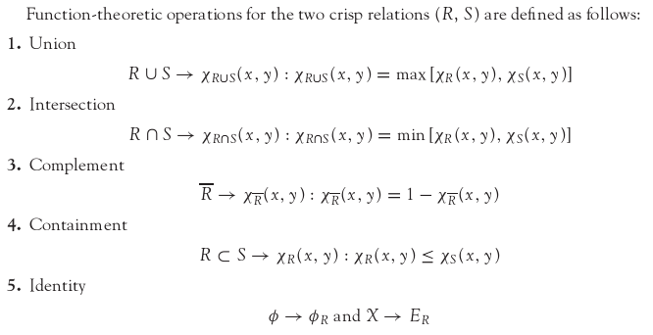
OPERATIONS ON CRISP RELATIONS
“Principles of Soft Computing, 2nd Edition”
by S.N. Sivanandam & SN Deepa
Copyright © 2011 Wiley India Pvt. Ltd. All rights reserved.

Slide 8
PROPERTIES OF CRISP RELATIONS
The properties of crisp sets (given below) hold good for crisp relations as well.
        Commutativity,
        Associativity,
        Distributivity,
        Involution,
        Idempotency,
        DeMorgan’s Law,
        Excluded Middle Laws.
“Principles of Soft Computing, 2nd Edition”
by S.N. Sivanandam & SN Deepa
Copyright © 2011 Wiley India Pvt. Ltd. All rights reserved.

Slide 9
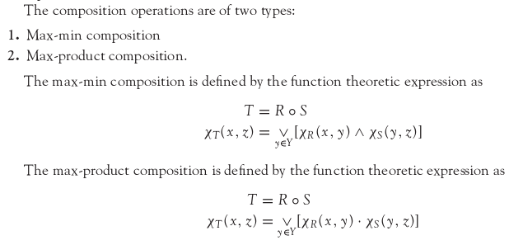
COMPOSITION ON CRISP RELATIONS
“Principles of Soft Computing, 2nd Edition”
by S.N. Sivanandam & SN Deepa
Copyright © 2011 Wiley India Pvt. Ltd. All rights reserved.

Slide 10
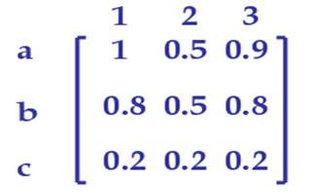
FUZZY CARTESIAN PRODUCT
Let R be a fuzzy subset of M and S be a fuzzy subset of N. Then the Cartesian product R × S is a fuzzy subset of N × M such that
Example:
Let R be a fuzzy subset of {a, b, c} such that R = a/1 + b/0.8 + c/0.2 and S be a fuzzy subset of {1, 2, 3} such that S = 1/1 + 3/0.8 + 2/0.5. Then R x S is given by
“Principles of Soft Computing, 2nd Edition”
by S.N. Sivanandam & SN Deepa
Copyright © 2011 Wiley India Pvt. Ltd. All rights reserved.

Slide 11
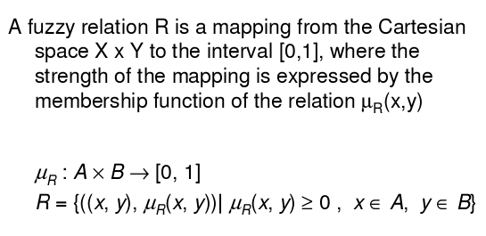
FUZZY RELATION
“Principles of Soft Computing, 2nd Edition”
by S.N. Sivanandam & SN Deepa
Copyright © 2011 Wiley India Pvt. Ltd. All rights reserved.

Slide 12
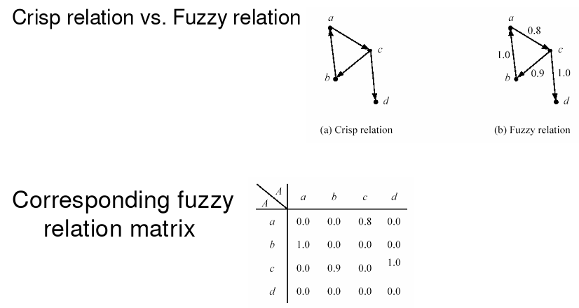
“Principles of Soft Computing, 2nd Edition”
by S.N. Sivanandam & SN Deepa
Copyright © 2011 Wiley India Pvt. Ltd. All rights reserved.

Slide 13

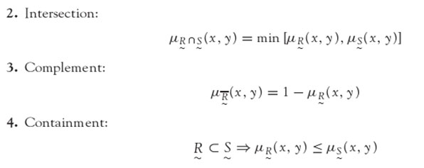
OPERATIONS ON FUZZY RELATION
The basic operation on fuzzy sets also apply on fuzzy relations.
“Principles of Soft Computing, 2nd Edition”
by S.N. Sivanandam & SN Deepa
Copyright © 2011 Wiley India Pvt. Ltd. All rights reserved.

Slide 14
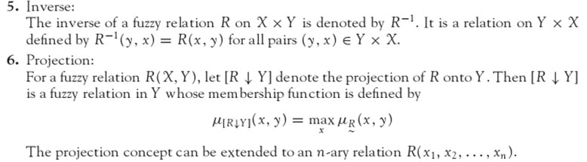
“Principles of Soft Computing, 2nd Edition”
by S.N. Sivanandam & SN Deepa
Copyright © 2011 Wiley India Pvt. Ltd. All rights reserved.

Slide 15
PROPERTIES OF FUZZY RELATIONS
The properties of fuzzy sets (given below) hold good for fuzzy relations as well.
        Commutativity,
        Associativity,
        Distributivity,
        Involution,
        Idempotency,
        DeMorgan’s Law,
        Excluded Middle Laws.
“Principles of Soft Computing, 2nd Edition”
by S.N. Sivanandam & SN Deepa
Copyright © 2011 Wiley India Pvt. Ltd. All rights reserved.

Slide 16
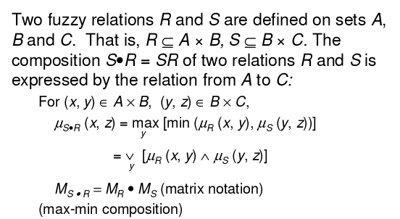
COMPOSITION OF FUZZY RELATIONS
“Principles of Soft Computing, 2nd Edition”
by S.N. Sivanandam & SN Deepa
Copyright © 2011 Wiley India Pvt. Ltd. All rights reserved.

Slide 17
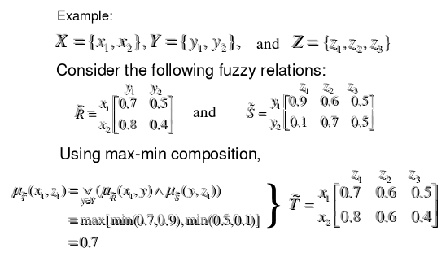
“Principles of Soft Computing, 2nd Edition”
by S.N. Sivanandam & SN Deepa
Copyright © 2011 Wiley India Pvt. Ltd. All rights reserved.

Slide 18
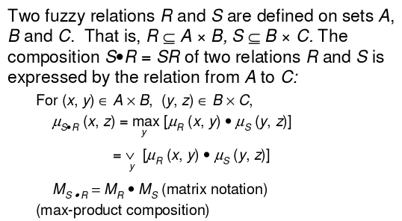
“Principles of Soft Computing, 2nd Edition”
by S.N. Sivanandam & SN Deepa
Copyright © 2011 Wiley India Pvt. Ltd. All rights reserved.

Slide 19
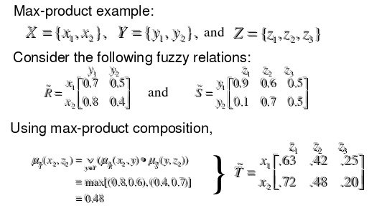
“Principles of Soft Computing, 2nd Edition”
by S.N. Sivanandam & SN Deepa
Copyright © 2011 Wiley India Pvt. Ltd. All rights reserved.

Slide 20
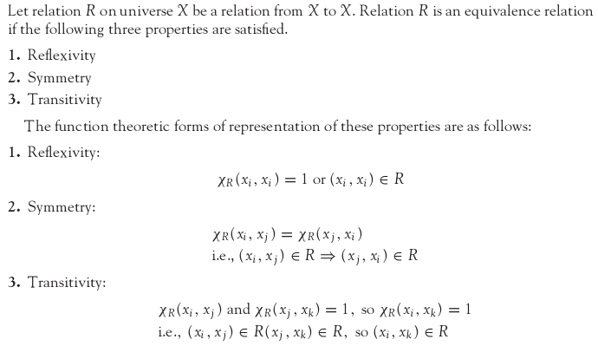
CLASSICAL EQUIVALENCE RELATION
“Principles of Soft Computing, 2nd Edition”
by S.N. Sivanandam & SN Deepa
Copyright © 2011 Wiley India Pvt. Ltd. All rights reserved.

Slide 21
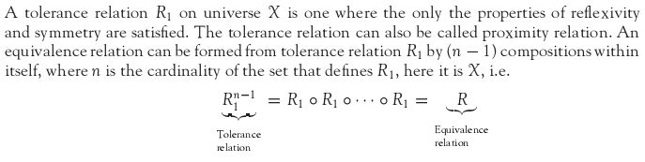
CLASSICAL TOLERANCE RELATION
“Principles of Soft Computing, 2nd Edition”
by S.N. Sivanandam & SN Deepa
Copyright © 2011 Wiley India Pvt. Ltd. All rights reserved.

Slide 22
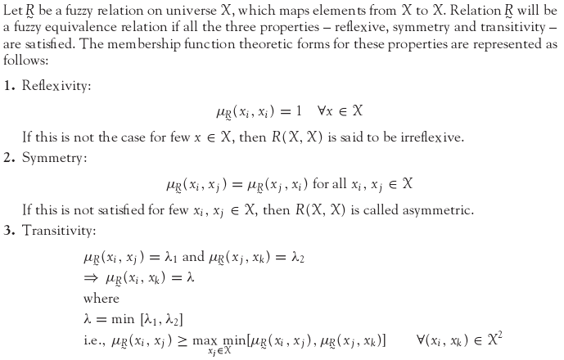
FUZZY EQUIVALENCE RELATION
“Principles of Soft Computing, 2nd Edition”
by S.N. Sivanandam & SN Deepa
Copyright © 2011 Wiley India Pvt. Ltd. All rights reserved.

Slide 23

FUZZY TOLERANCE RELATION
A binary fuzzy relation that possesses the properties of reflexivity and symmetry is called fuzzy tolerance relation or resemblance relation.
The equivalence relations are a special case of the tolerance relation. The fuzzy tolerance relation can be reformed into fuzzy equivalence relation in the same way as a crisp tolerance relation is reformed into crisp equivalence relation, i.e.,
where ‘n’ is the cardinality of the set that defines R1.
“Principles of Soft Computing, 2nd Edition”
by S.N. Sivanandam & SN Deepa
Copyright © 2011 Wiley India Pvt. Ltd. All rights reserved.

Slide 24
SUMMARY
The chapter provides the definition, properties, and operations of the following:
Classical sets,
Fuzzy sets,
Classical relations,
Fuzzy relations.
The chapter also discusses crisp and fuzzy equivalence and tolerance relations.
“Principles of Soft Computing, 2nd Edition”
by S.N. Sivanandam & SN Deepa
Copyright © 2011 Wiley India Pvt. Ltd. All rights reserved.

